Slide 1

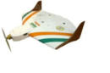
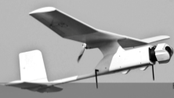
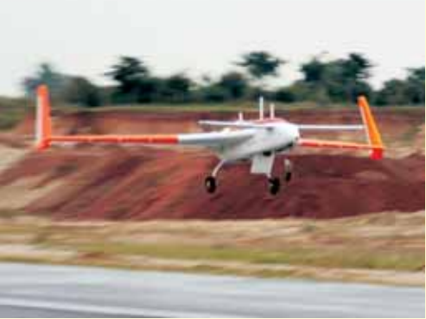
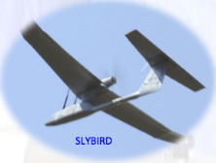
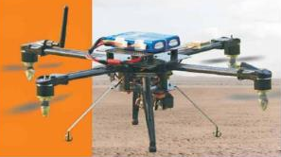
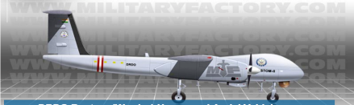
INTEGRATION OF DRONES IN NON SEGREGATED AIR SPACE
RK Narang
Centre For Air Power Studies

Slide 2

Challenges
Technological Initiatives
Initiatives by the US and EU
Why Full Integration may continue to be a Challenge?
Status of UAV Integration in India

Slide 3
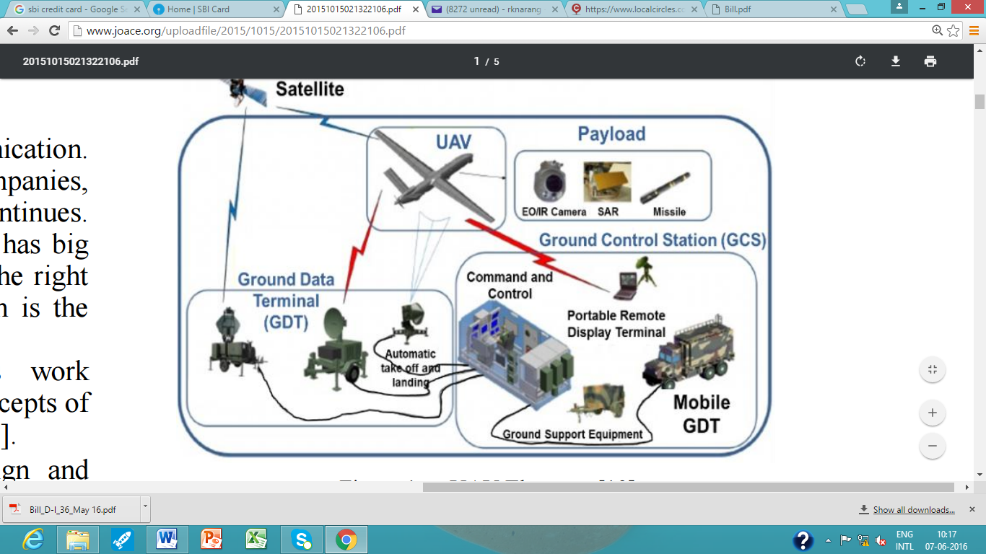
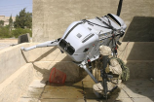
Technological Challenges
Cooperative and Non-Cooperative traffic
Collision and Traffic Avoidance System
  Airborne Sense and Avoid System
  Ground based Traffic and Collision Avoidance Systems
Data Links
  Lost Link
  Vulnerability of Data Links
Accidents/ Incidents
Human Factors
Ergonomics

Slide 4
Regulatory Factors
  Traffic Separation and Collision Avoidance in VFR and IFR
  Licensing and Certification
  Formulating Specification of UAVs
  Distributed Control
    Line of Sight
    Beyond Line of Sight
Notes:
-UAV operations in non-segregated airspace means that both Unmanned and Manned aircraft operate in the same airspace
-In IAF, RPA is used, DGCA has used term unmanned aircraft (UA) but I would use the term UAV today.
-UAV development initially dominated by military
-Rising capability of military UAVs and their successful employment led to development of armed and combat UAVs
-Strategic Defence intelligence, a market research company, estimates that UCAV are likely to account for 34% of UAV market
-Long Duration Surveillance and operation over inaccessible areas are some of the Unique capabilities of UAV, which have made them favourable platform for civil applications at lower cost
UAVs susceptible to
breaking of command and control signals,
Hacking of data links for feeding spurious information and
clandestine exploitation of own UAVs by adversaries/ terrorists
UAVs presently operating in segregated airspace

Slide 5
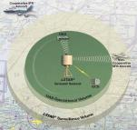
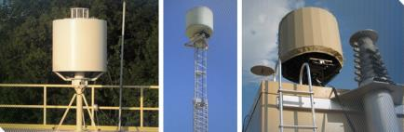
Technological Initiatives
Ground Based Sense and Avoid (GBSAA) System
Airborne Radar for Collision Avoidance
DARPA’s Sense and Avoid System tested in May 2016
Automatic Dependent Surveillance and Broadcast (ADS-B)
Mid-Air Collision Avoidance System (MIDCAS)

Slide 6
Initiatives by The US
FAA Modernisation and Reforms Act 2012
  Operational Areas in Arctic
    ConcoPhillips Insitu’s Scan Eagle UAVs and BP’s AeoVironment’s Puma AE UAV given permission in 2014
    For marine mammals, ice surveys, pipelines, roads and equipment in Alaska
Centres of Excellence
Drone Advisory Committee
Test Sites

Slide 7
Initiatives by EU
Roadmap for Integration of RPAS
  Light RPA operation between 2014 and 2018
  Extending RPA operations in IFR and initiation of VFR operations between 2019-2023
  Full Integration between 2024 and 2028
Published Technical Opinion in December 2015
Aims to come up with new rules and amend existing rules during 2016-17

Slide 8
Why Integration May Take Longer?
Accident Rate
  Commercial Manned Aircraft is between 0.1 to 0.001
  Accident rate of Predator UAVs reduced from 7.5 to 4.9 and Reaper from 16.4 in 2009 to 3.17 in 2014, which is closer to accident rate of fighter aircraft but well below commercial aircraft
Technology is still a Challenge
Regulation- A slow and cautious integration

Slide 9
UAV Integration in India
DGCA came up with Draft Circular titled “Guidelines for obtaining Unique Identification Number (UIN) and Operation of Civil Unmanned Aircraft System (UAS) in April 2016.
  Need to make single window clearance
  Reduce minimum time for submission of application
  Requirement of PPL and FRTOL appears to be a stringent qualification for small UAV operators
  Validity of UA licence could be increased from two years to five years

Slide 10
UAV Integration in India
A Way Ahead
Roadmap for integration of UAVs
Need to develop enabling technologies
  Ground Based UAV traffic separation system
  Airborne Conflict and Avoidance System
Test Sites
Collaboration with Industry and Academia

Slide 11
Thank You

